Slide 1
Probability and probability distributions
NRES 776
Instructor: Heather Bryan
Sept 28, 2020

Slide 2
Learning Objectives
Describe the connection between probability and statistical reasoning
Apply standard probability rules to calculate the probabilities of complex events
Use Baye’s theorem to translate between probabilistic statements

Slide 3
Samples vs Populations
Statistics is used to learn about the population from the data (sample)
Need to make educated guesses of parameters using estimates from samples
Estimates differ from parameters by chance
Probability is used to quantify uncertainty

Slide 4
Probability
What is the probability that the mean of a sample differs from the population mean?
What is the probability that the means of two samples are different?
What is the probability that two variables are independent?

Slide 5
Probability
Proportion of times an event would occur if we repeated a random trial over and over again under the same conditions (Range: 0 and 1)

Slide 6
Probability
Proportion of times an event would occur if we repeated a random trial over and over again under the same conditions (Range: 0 and 1)
Random trial is a process with two or more outcomes whose occurrence cannot be predicted with certainty (1 outcome/trial)

Slide 7
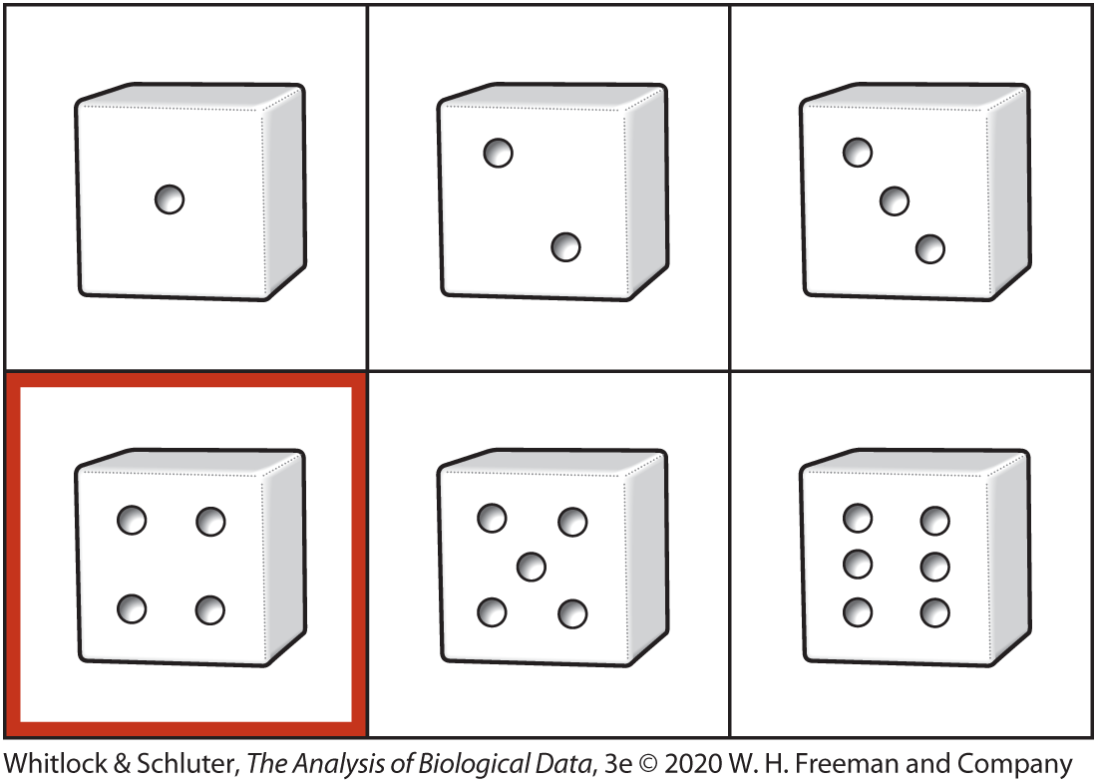
Probability
Proportion of times an event would occur if we repeated a random trial over and over again under the same conditions (Range: 0 and 1)
Random trial is a process with two or more outcomes whose occurrence cannot be predicted with certainty (1 outcome/trial)
Pr[rolling a 4] = 1/6 = 0.17

Slide 8
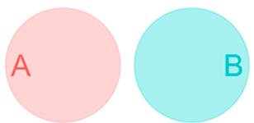
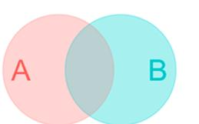
Foundational Concepts in Probability
Sample space The world of potential outcomes
Mutually exclusive events
Non-exclusive events
Notes:
Mutually exclusive events cannot occur at the same time (e.g., cannot have a six and a one if you role a dice, the result is either a six or a one)
-an animal cannot have teeth and feathers
Non-exclusive events are when both A and B can occur at the same time (e.g., some animals wings and feathers)

Slide 9
Probability Distributions
List of probabilities of all mutually exclusive outcomes of a random trial
Discrete or Continuous

Slide 10
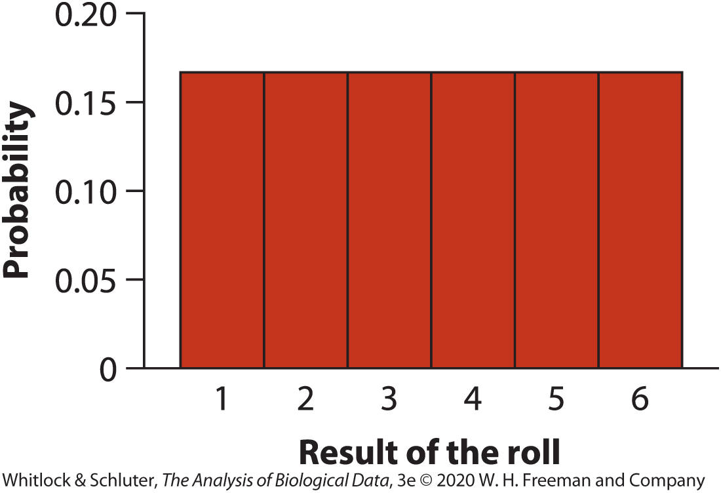
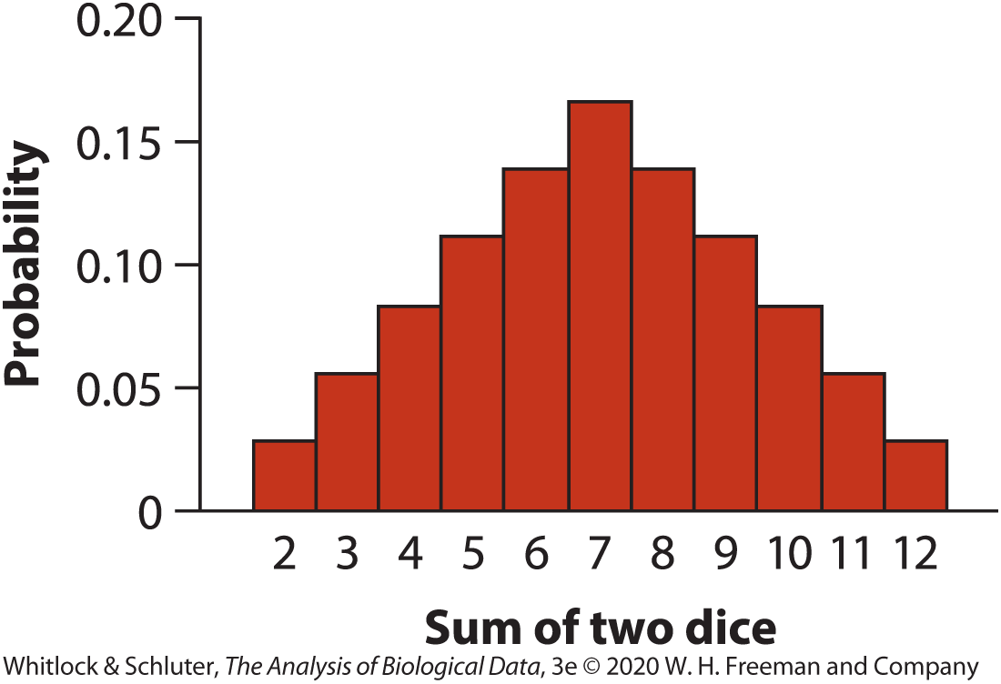
Discrete Probability Distributions
Discrete variables: numerical variables with indivisible units and categorical variables
Finite probability for each outcome
Sums to 1
Single dice
Two dice
Notes:
e.g., .167*6 = 1 for the single dice example

Slide 11
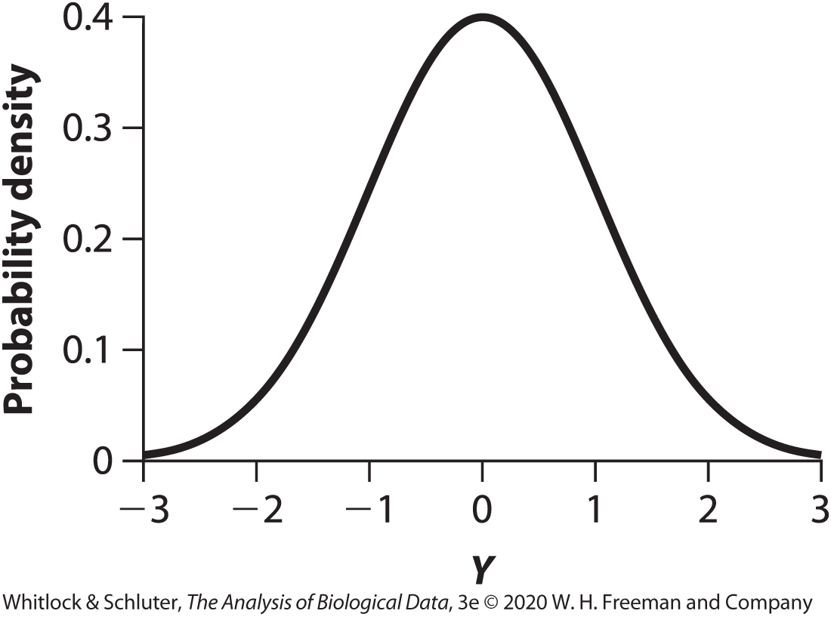
Continuous Probability Density
Continuous numerical variables that can take on any real number within a range
Can describe probability of a range of values for a variable
E.g., normal distribution

Slide 12
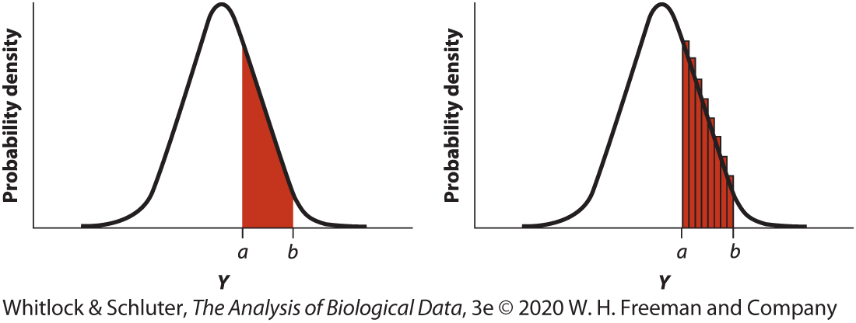
Continuous Probability Density
E.g., sample random number Y from normal distribution
Probability that Y = 2.4 is almost 0; probability that Y will fall between two values can be calculated by integration (e.g., Pr[a<Y<b])
Area under curve integrates to 1

Slide 13
Probability Rules: Addition Principle Mutually Exclusive Outcomes
Pr[A or B] = Pr[A] + Pr[B]

Slide 14
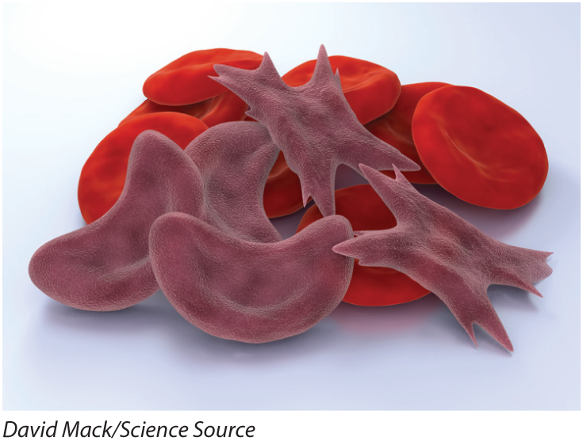
Probability Rules: Addition Principle Mutually Exclusive Outcomes
Pr[A or B]= Pr[A] + Pr[B]
What is the probability that a randomly chosen person has blood type O+ or AB+?
Blood type | Probability
O+ | 0.374
O− | 0.066
A+ | 0.357
A− | 0.063
B+ | 0.085
B− | 0.015
AB+ | 0.034
AB− | 0.006

Slide 15
Probability Rules: Addition Principle Mutually Exclusive Outcomes
Pr[A or B]= Pr[A] + Pr[B]
What is the probability that a randomly chosen person has blood type O+ or AB+?
Pr[O+] + Pr[AB+] = 0.374+0.034 = 0.408
Blood type | Probability
O+ | 0.374
O− | 0.066
A+ | 0.357
A− | 0.063
B+ | 0.085
B− | 0.015
AB+ | 0.034
AB− | 0.006

Slide 16
Probability Rules: Probability of Not
ΣPr[X] = 1 therefore Pr[not x] = 1 – P[x]

Slide 17
Probability Rules: Probability of Not
ΣPr[X] = 1 therefore Pr[not x] = 1 – P[X]
What is the probability that a randomly chosen person does not have blood type O+ or AB+?
Blood type | Probability
O+ | 0.374
O− | 0.066
A+ | 0.357
A− | 0.063
B+ | 0.085
B− | 0.015
AB+ | 0.034
AB− | 0.006

Slide 18
Probability Rules: Probability of Not
ΣPr[X] = 1 therefore Pr[not x] = 1 – P[X]
What is the probability that a randomly chosen person does not have blood type O+ or AB+?
Pr[not O+ Or AB+] = 1 - 0.408 = 0.592
Blood type | Probability
O+ | 0.374
O− | 0.066
A+ | 0.357
A− | 0.063
B+ | 0.085
B− | 0.015
AB+ | 0.034
AB− | 0.006

Slide 19
Probability Rules: General Addition Principle
Pr[A or B]= Pr[A] + Pr[B] − Pr[A and B]

Slide 20
Probability Rules: General Addition Principle
Pr[A or B]= Pr[A] + Pr[B] − Pr[A and B]
What is the probability that a randomly chosen person has blood type O or is Rh +?
Blood type | Probability
O+ | 0.374
O− | 0.066
A+ | 0.357
A− | 0.063
B+ | 0.085
B− | 0.015
AB+ | 0.034
AB− | 0.006

Slide 21
Probability Rules: General Addition Principle
Pr[A or B]= Pr[A] + Pr[B] − Pr[A and B]
What is the probability that a randomly chosen person has blood type O or is Rh +?
Pr[O] + Pr[+] – P[O and +] = (0.374+0.066) + (0.374+0.357+0.085+0.034) – 0.374 = 0.916
Blood type | Probability
O+ | 0.374
O− | 0.066
A+ | 0.357
A− | 0.063
B+ | 0.085
B− | 0.015
AB+ | 0.034
AB− | 0.006

Slide 22
Probability Rules: Multiplication
For independent events:
P[A & B] = P[A] P[B]

Slide 23
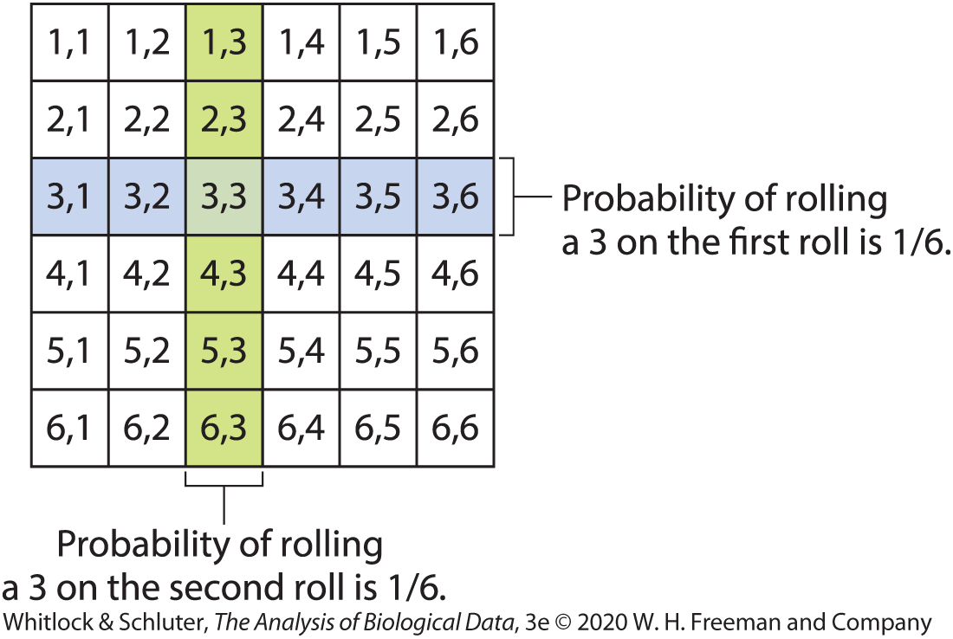
Probability Rules: Multiplication
For independent events:
P[A & B] = P[A] P[B]
E.g., Probability of rolling a 3 on first roll and a 3 on the second roll of a dice
1/6 * 1/6 = 1/36 = 0.028
Notes:
Probability of all mutually exclusive events

Slide 24
Probability Rules: Multiplication
For dependent events:
P[A & B] ≠ P[A] P[B]

Slide 25
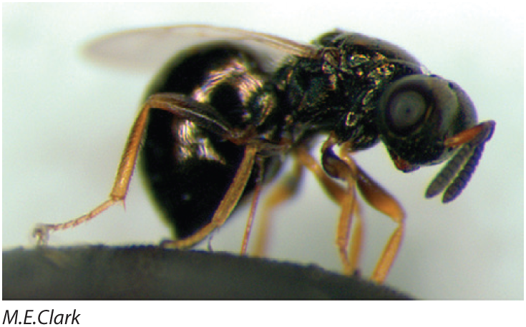
Probability Rules: Multiplication
For dependent events:
P[A & B] ≠ P[A] P[B]
e.g., jewel wasps lay their eggs in fly larvae and can alter sex ratio of their offspring depending on whether the larvae has already been parasitized or not

Slide 26
Probability Rules: Multiplication
Assume Pr[host is already parasitized] = 0.2
If unparasitized, Pr[laying a female egg] = 0.95
If parasitized, Pr[female egg] is 0.1

Slide 27
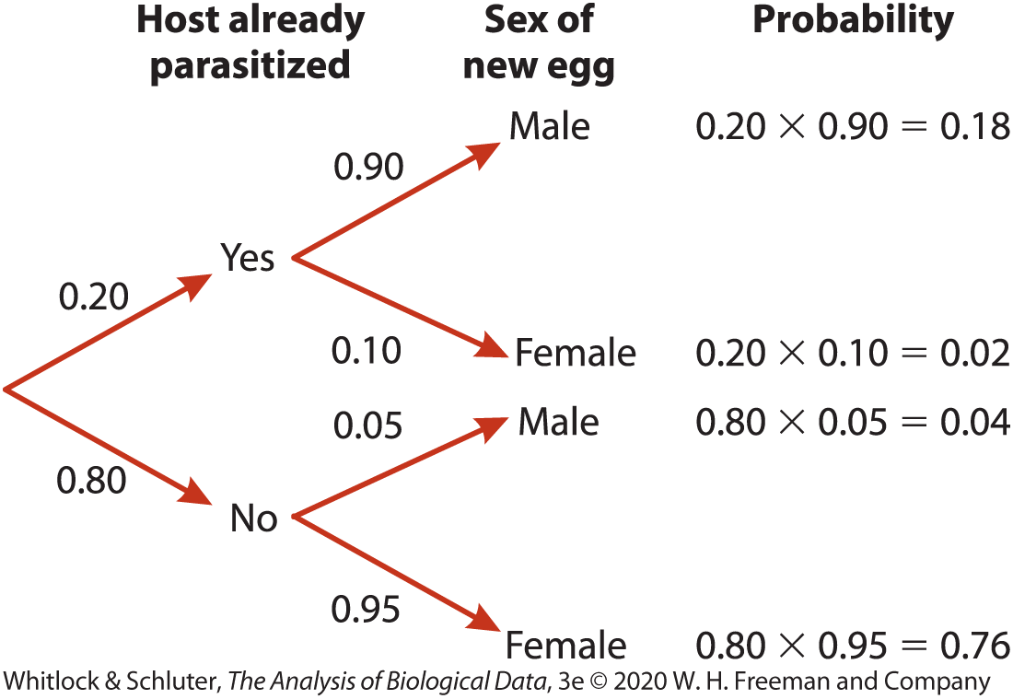
Probability Rules: Multiplication
Assume Pr[host is already parasitized] = 0.2
If unparasitized, Pr[laying a female egg] = 0.95
If parasitized, Pr[female egg] is 0.1

Slide 28
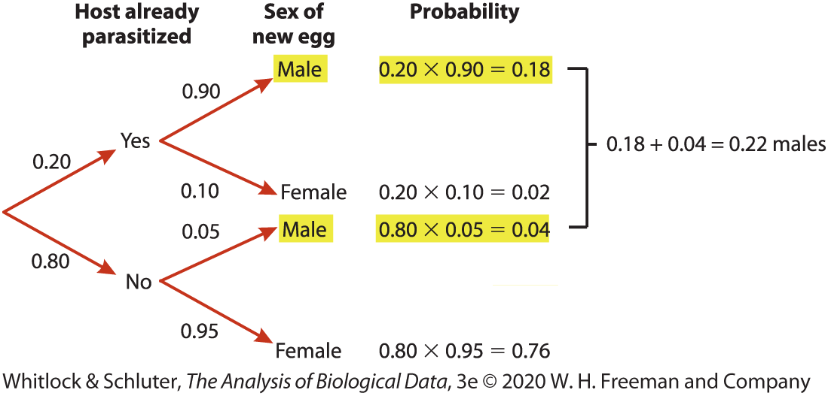
Probability Rules: Multiplication
What is the probability that a new, randomly chosen egg is male?

Slide 29
Probability Rules: Multiplication
Are the events ‘host already parasitized’ (A) and ‘sex of new egg being male’ (B) independent?

Slide 30
Probability Rules: Multiplication
Are the events ‘host already parasitized’ (A) and ‘sex of new egg being male’ (B) independent?
If yes, then P(A&B) = P(A) P(B) = 0.22 x 0.20 = 0.44
0.44 ≠ 0.18

Slide 31
Probability Rules: Multiplication
Are the events ‘host already parasitized’ (A) and ‘sex of new egg being male’ (B) independent?
If yes, then P(A&B) = P(A) P(B) = 0.22 x 0.20 = 0.44
0.44 ≠ 0.18
Therefore events not independent

Slide 32
Conditional Probability
Probability of an event occurring given that a condition is met
Law of total probability
P[X] = ∑(P[X|Y_{i}]P[Y_{i}])
Weighting conditional probabilities by the probability of the condition (Y_{i}) and
Summing over all conditions

Slide 33
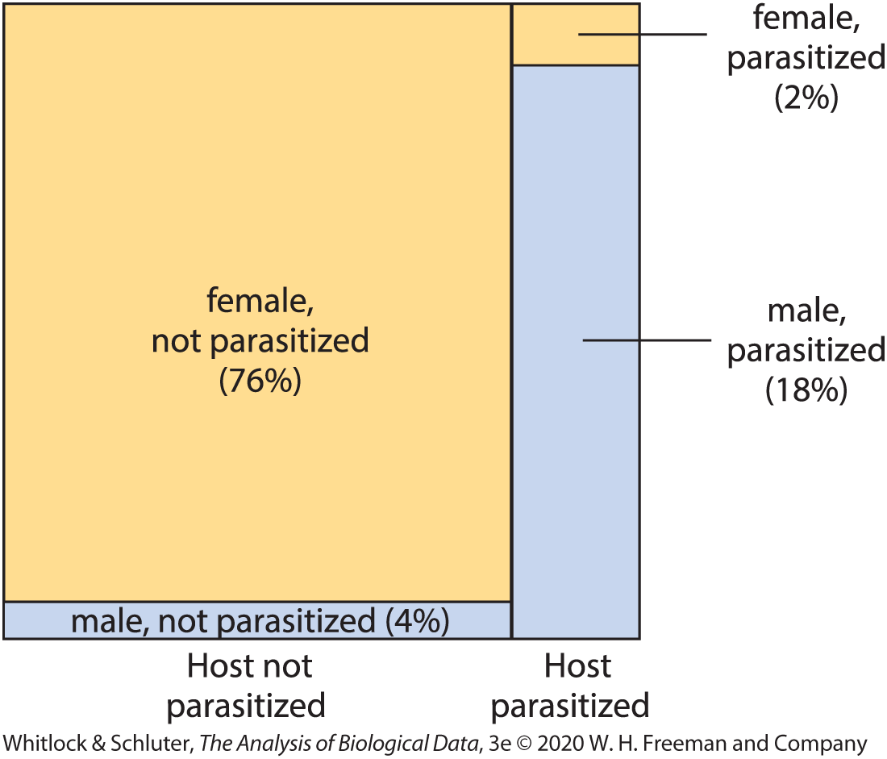
Conditional Probability
P[egg is male] = Pr[host already parasitized]*Pr[egg is male|host already parasitized] + Pr[host not parasitized]*Pr[egg is male|host not parasitized]
= (0.20*0.9) + (0.80*0.05) = 0.22

Slide 34
Probability Rules: General Multiplication
For dependent events:
P[A & B] = P[A] P[B|A]

Slide 35
Probability Rules: General Multiplication
For dependent events:
P[A & B] = P[A] P[B|A]
e.g., what is the probability that an egg is male and the host was parasitized?
= 0.2 x 0.8 = 0.18

Slide 36
Sampling without Replacement
Outcome of one random trial eliminates or depletes an outcome from all possible outcomes and changes the probability distribution of values for subsequent random trials

Slide 37

Sampling without Replacement
Outcome of one random trial eliminates or depletes outcome from possibilities and changes the probability distribution of values for subsequent random trials
E.g., What is the probability of drawing Ace-2-3 from a deck of cards?
P(Ace) = 4/52
P(2) = 4/51
P(3) = 4/50

Slide 38
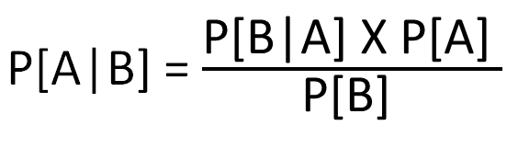
Bayes Theorem
The probability of A given B equals the probability of B given A times the probability of A divided by the probability of B

Slide 39
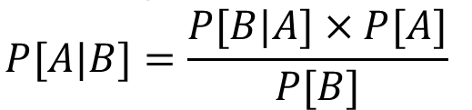
Bayes Theorem: Derivation
We know
P[A&B] = P[B] × P[A|B] AND
P[A&B] = P[A] × P[B|A]
Clearly, P[A&B] = P[A&B] so
P[B] × P[A|B] = P[A] × P[B|A]
Divide both sides by P[B] to find

Slide 40

Bayes Theorem: Example
Down syndrome occurs in 1/1000 pregnancies. The test for down syndrome has a sensitivity (i.e., probability of correctly identifying a fetus with down syndrome) of 0.60 and a false-positive rate of 0.05. What is the probability that a fetus with a positive test result actually has down syndrome?
$$\operatorname{Pr}\left[DS | positive result\right]$$
$$= \frac{\operatorname{Pr}\left[positive result | DS\right]Pr⁡[DS]}{Pr⁡[positive result]}$$
Notes:
-we’ve been given the probability of a positive result for fetuses with down syndrome (0.6) and the probability of down syndrome (0.001)
-need to calculate probability of a positive result

Slide 41

Bayes Theorem: Example
$$\operatorname{Pr}{[positive result]}=\operatorname{Pr}\left[positive result | DS\right]\operatorname{Pr}\left[DS\right]+\operatorname{Pr}\left[positive result | noDS\right]=\left(0.60 ×0.001\right)+\left[0.05×\left(1−0.001\right)\right]=0.05055$$
$= \frac{\operatorname{Pr}\left[positive result | DS\right]Pr⁡[DS]}{Pr⁡[positive result]}=$ $\frac{0.60×0.001}{0.0505}$ = 0.012

Slide 42











Summary
Addition rule (or)
$$C$$
$$E$$
$$P\left(C∪E\right)=P\left(C\right)+P\left(E\right)$$
$$P\left(C∪F\right)=P\left(C\right)+P\left(F\right)−P\left(C∩F\right)$$
$$C$$
$$F$$
Multiplication rule (and)
$$P\left(C ∩F\right)=P\left(C\right)×P\left(F\right)$$
$$C$$
$$F$$
Conditional probability (given)
$$P\left(C |F\right)=\frac{P\left(C∩F\right)}{P\left(F\right)}$$
$$F$$
$$C$$
Notes:
Probability of all mutually exclusive events

Slide 43
Practice
Please see PDF files in Blackboard for practice questions & answers
Notes:
Probability of all mutually exclusive events

